Slide 1
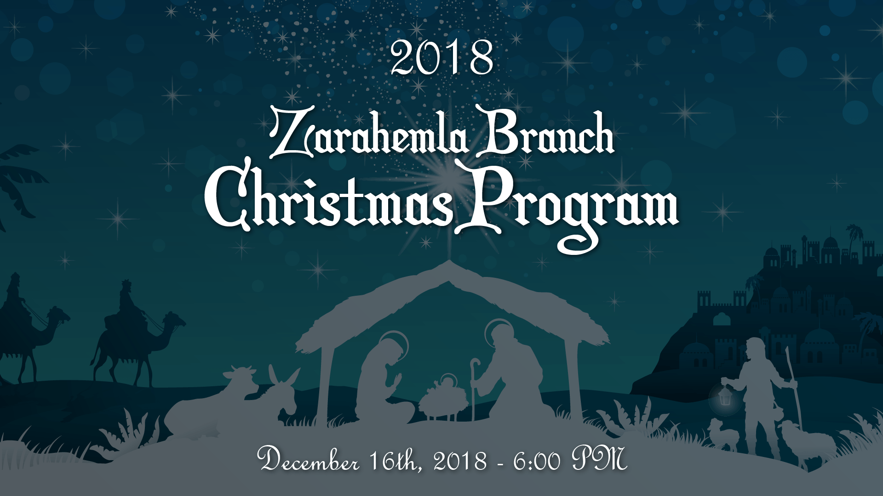

Slide 2

2018
Zarahemla Branch
Christmas Program
Elder Abraham Forth
Welcome / Invocation

Slide 3
2018
Zarahemla Branch
Christmas Program
John 1:1-4, Genesis 5:44
Scripture Reading

Slide 4
2018
Zarahemla Branch
Christmas Program
“Praise the Lord!”
Ashley Gault, pianist

Slide 5
2018
Zarahemla Branch
Christmas Program
Ether 1:77-78, Mosiah 1:97,100,102
Scripture Reading

Slide 6
2018
Zarahemla Branch
Christmas Program
Luke 2:4-7
Scripture Reading

Slide 7
2018
Zarahemla Branch
Christmas Program
Men’s Quartet
Ministry of Music

Slide 8
2018
Zarahemla Branch
Christmas Program
Luke 2:8-14
Scripture Reading

Slide 9
2018
Zarahemla Branch
Christmas Program
“Angels We Have Heard on High”
Ashley Gault, pianist

Slide 10
2018
Zarahemla Branch
Christmas Program
Luke 2:15-16
Scripture Reading

Slide 11
2018
Zarahemla Branch
Christmas Program
Sunday School Classes
Ministry of Music

Slide 12
2018
Zarahemla Branch
Christmas Program
Luke 2:17-20
Scripture Reading

Slide 13
2018
Zarahemla Branch
Christmas Program
Janet Forth
Ministry of Music

Slide 14
2018
Zarahemla Branch
Christmas Program
Matthew 3:1-2, 8-11
Scripture Reading

Slide 15
2018
Zarahemla Branch
Christmas Program
Men’s Quartet
Ministry of Music

Slide 16
2018
Zarahemla Branch
Christmas Program
Matthew 3:24, III Nephi 4:51-52
Scripture Reading

Slide 17
2018
Zarahemla Branch
Christmas Program
“To Us a Child of Hope is Born”
Ashley Gault, pianist

Slide 18
2018
Zarahemla Branch
Christmas Program
Matthew 24:32, D&C 65:1c-d
Scripture Reading

Slide 19
2018
Zarahemla Branch
Christmas Program
Men’s Quartet
Ministry of Music

Slide 20
2018
Zarahemla Branch
Christmas Program
Revelation 1:7, D&C 34:6c-d
Scripture Reading

Slide 21
2018
Zarahemla Branch
Christmas Program
“Hark, the Herald Angels Sing!”
Ashley Gault, pianist

Slide 22
2018
Zarahemla Branch
Christmas Program
High Priest Brad Gault
Benediction

